Slide 1

HYPOTHESIS
TESTING SUMMARY
Technology vs – Statistical Validation
US Retail 2015 – 2018 | Apex Planet Solutions
VarunKumar Vakamullu | February 2026

Slide 2

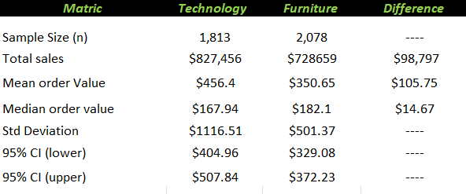
HYPOTHESIS
DESCRIPTIVE STATISTICS

Slide 3
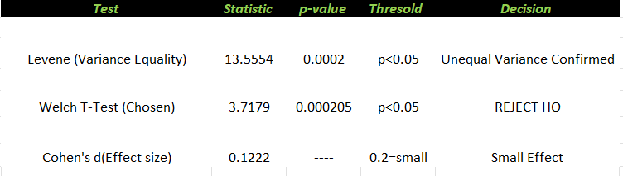
TEST RESULTS
P = 0.0002 is far below alpha = 0.05. We reject the null hypothesis. The difference in average order value between Technology and Furniture is statistically significant with 99.89% confidence
VERDICT:

Slide 4
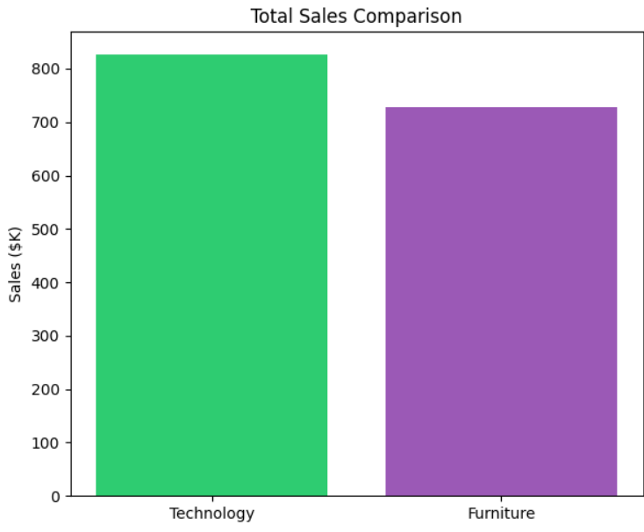
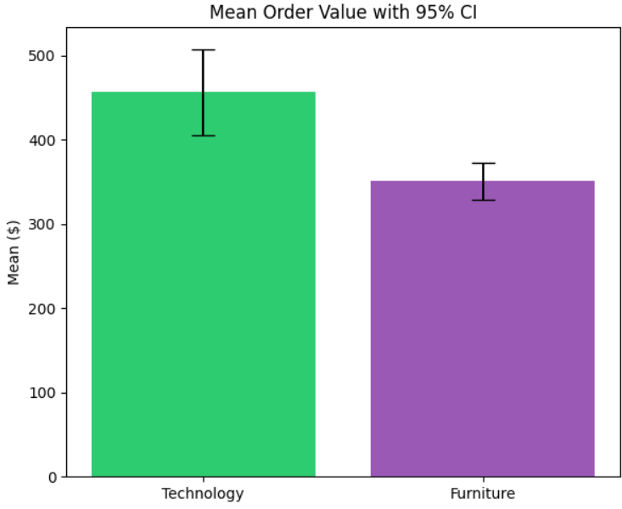
Visualizations:
Business Interpretation
Technology generates $105.75 more per order than Furniture on average — proven at 99.98% confidence.
The Levene test confirmed unequal variance (p=0.0002), so Welch T-Test was correctly chosen over standard
T-Test.
Cohen's d = 0.122 indicates a small but real effect — the difference is consistent, not a fluke.
Technology leads in EVERY segment: Consumer ($401K), Corporate ($244K), Home Office ($182K).
While statistically significant, the effect size is small — operational decisions should account for category volume
differences too.

